Slide 1



DevConnector
01
Connecting Developers across the globe

Slide 2

Group Members
Shubham Deodhar
02
Saurav Borah
RA1811027010010
RA1811027010051
J.Briskilal
Project Mentor

Slide 3
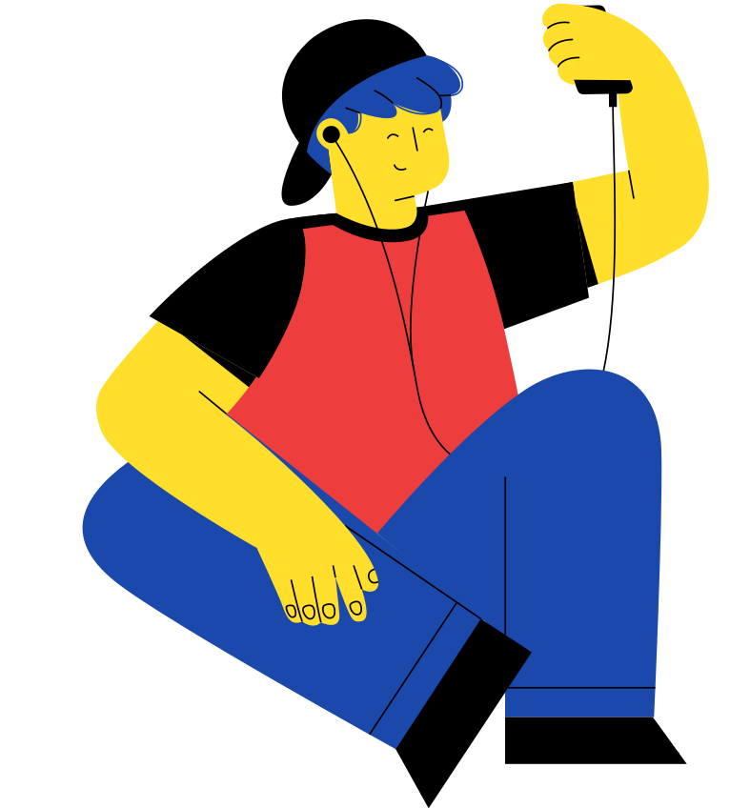
What is DevConnector ?
Overview of the project
This second decade of the 21st century in the software development aspect can be termed as “Era of Social media platforms”. Social media helps everyone to share their knowledge so that everyone in the society can stay up to date.
So that's why we decided to create our own model of social media platform named as “Dev-Connector” . It's a way to establish a network or a knowledge-based relationship among Developer community.
04

Slide 4


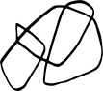

Objectives
05
We wanted to create a full stack project
Creating a Developer oriented Social media
In this project we used famous MERN Stack which stands for Mongo-Express-React-Node.
We wanted to create a developer oriented website , which would provide developer community a new social media platdorm

Slide 5
Technologies used in this project
React js
Node js
Express js
07
Redux, React-Redux
MongoDB Atlas
Heroku CLI

Slide 6

Real-Time Implementation
08

Slide 7
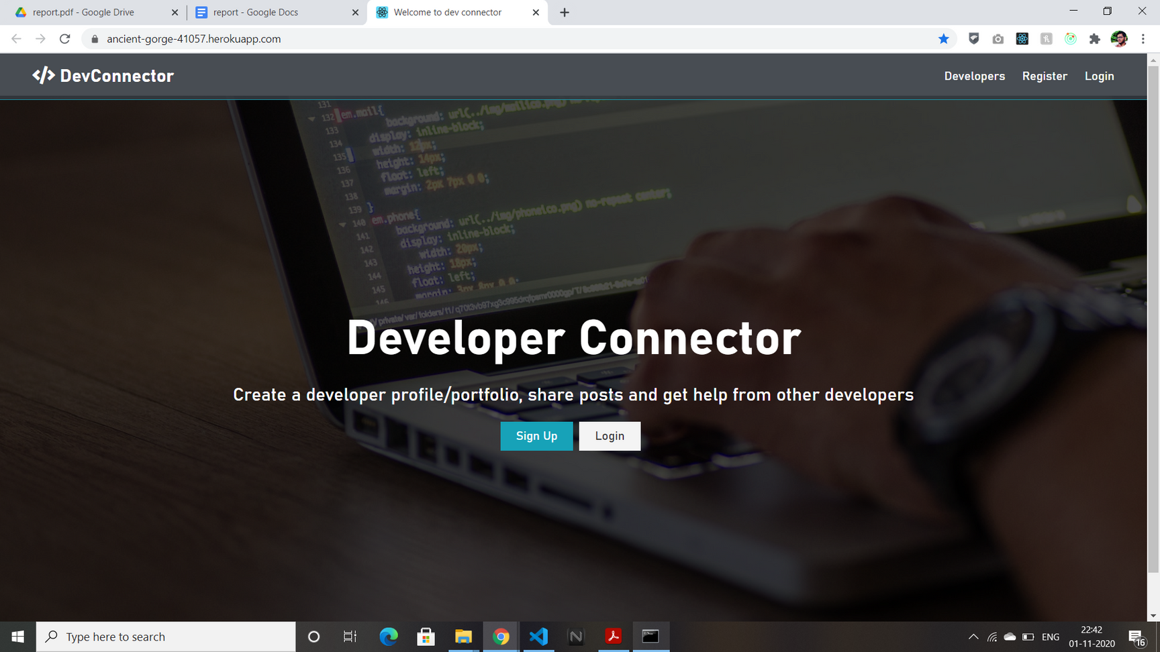
Landing page
09

Slide 8
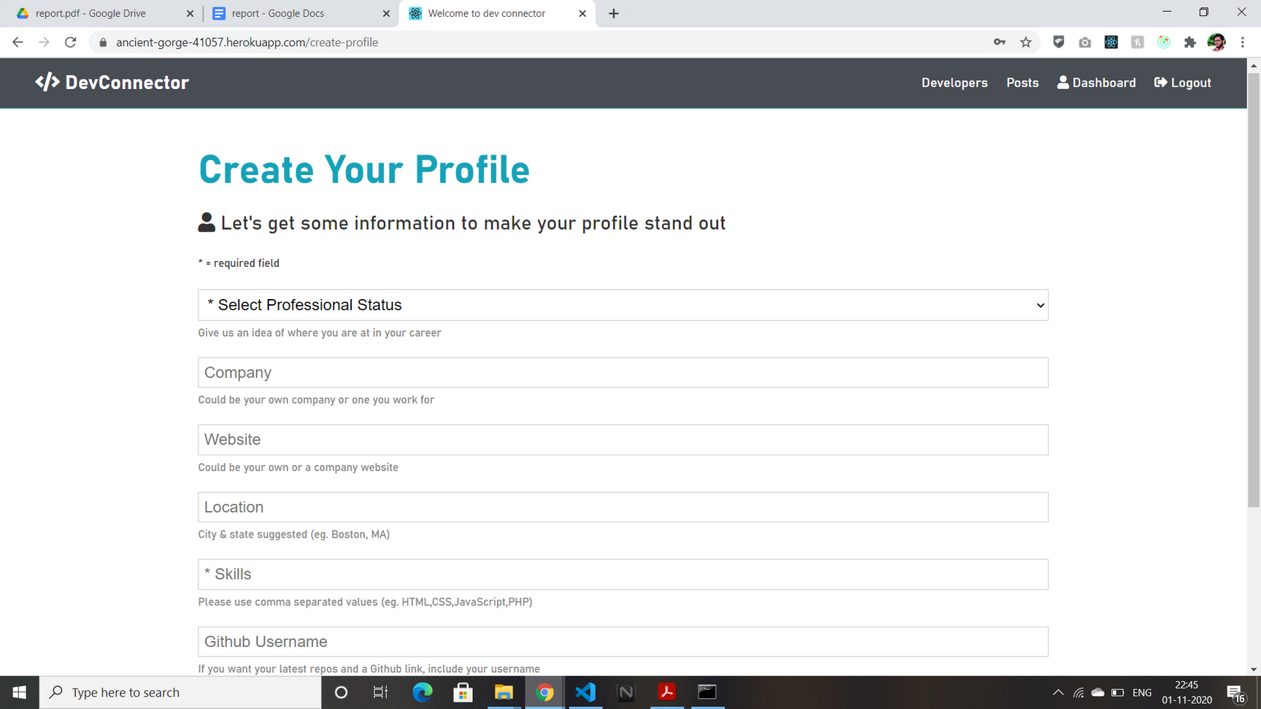
Creating a profile
09

Slide 9
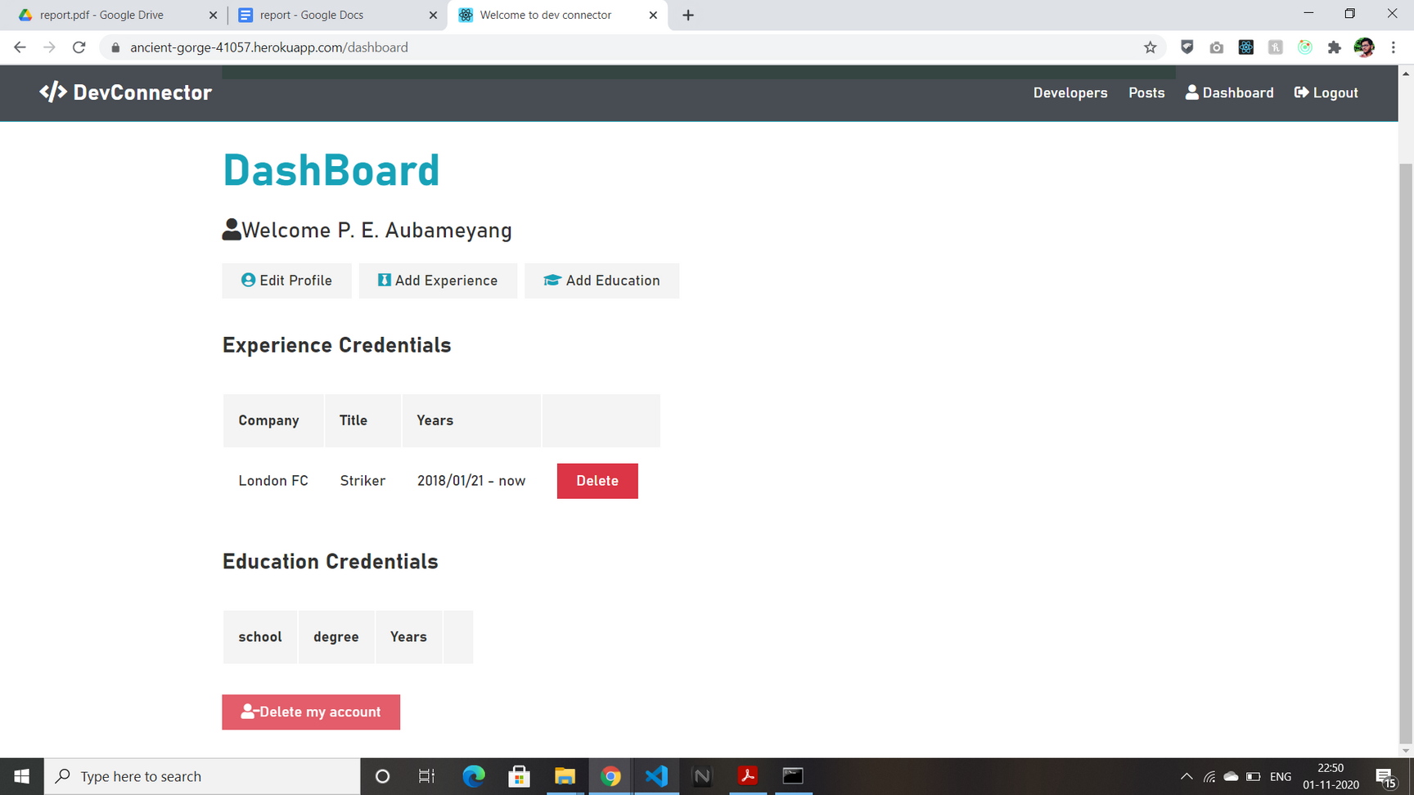
Your Own Dashboard
09

Slide 10
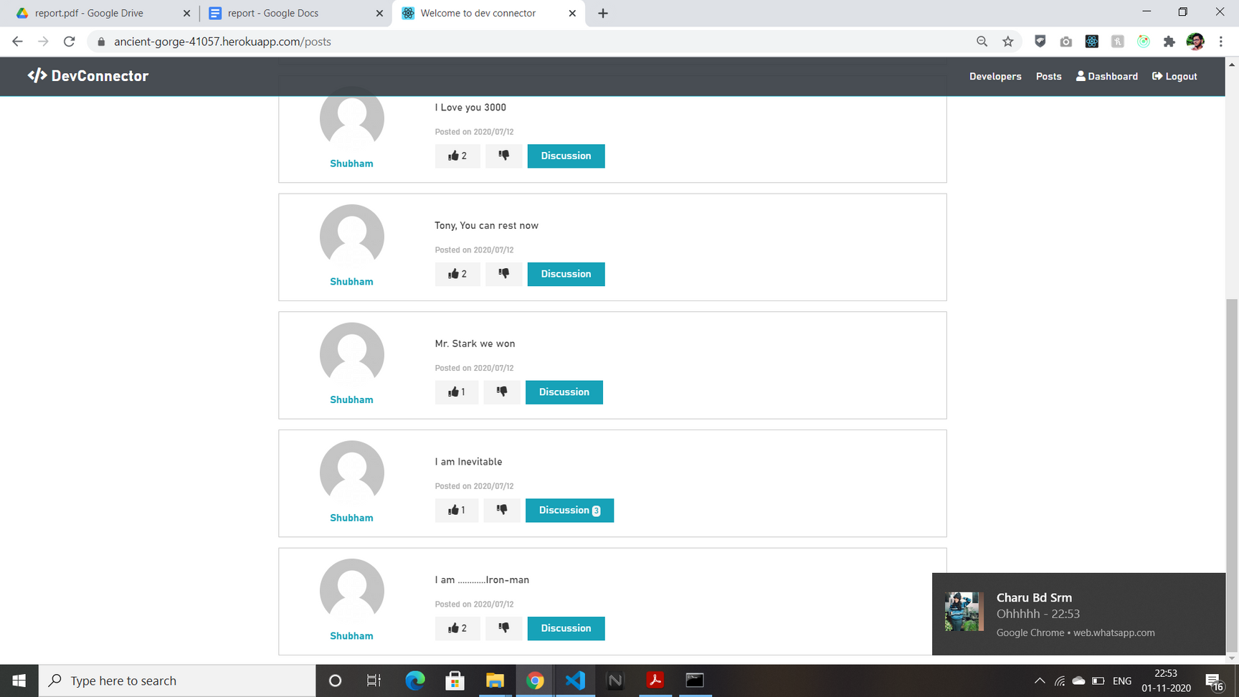
Live Social Posts
09

Slide 11
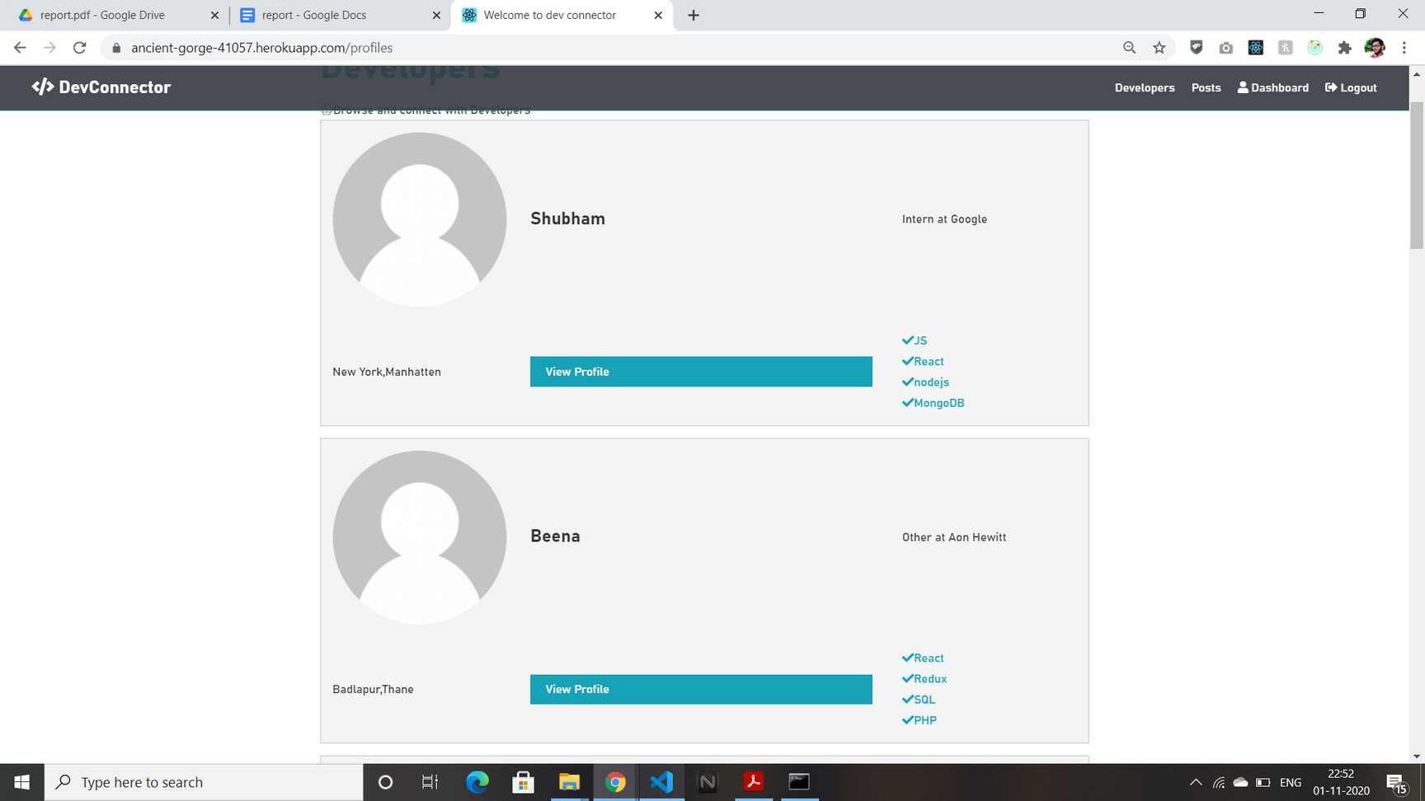
All Developers
09

Slide 12
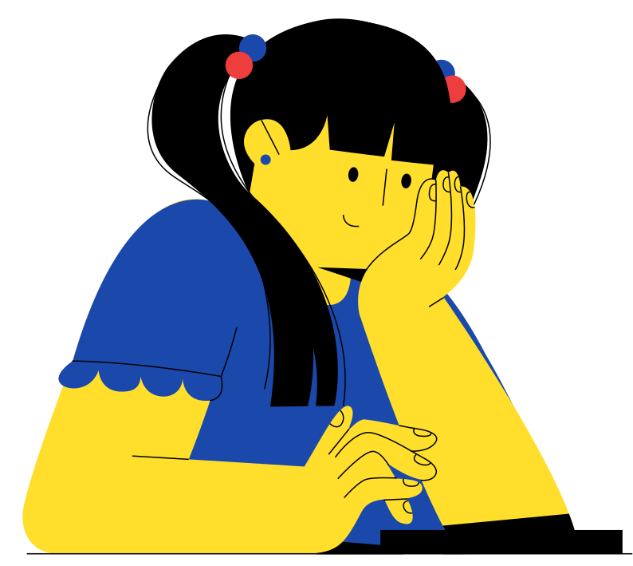
Results
13

Slide 13
Full Stack Project
We Successfully Created a full stack web development project using MERN Stack within 2 months
Results
Open Source
After creating this project in local system, we went open source by deploying our web app on Heroku.
14
Fully Functional Social Media Website
We created a fully functional social media website for developer community, with integration to already existing social media sites like Github and Medium.

Slide 14
Unable to form direct connection
We haven't provided a search option for developers yet , we are currently working on that
Limitations
Direct Messaging not available
14
In continuation to above point, our app does not have a personal level chatting mechanism yet, but we are not that far from achieving it.
Lack of ML Support
\We are trying to integrate a recommendation system so that user's feed will be filled with posts of his own interest

Slide 15
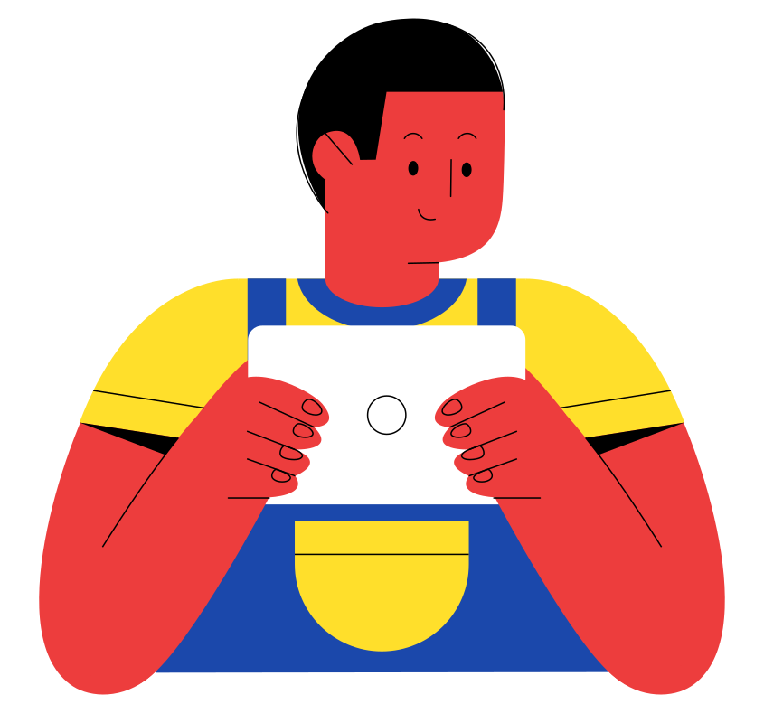
Conclusion
17

Slide 16
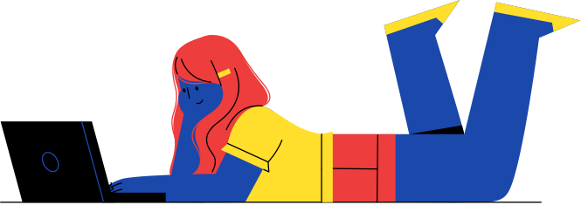
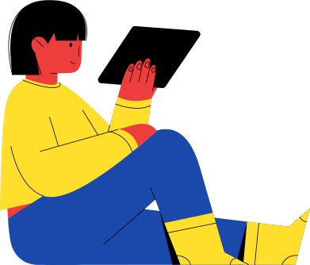
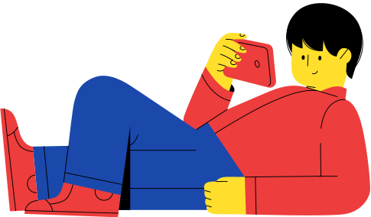
After Doing all the procedure , steps and Writing previously mentioned code , we were able to create a Full Stack web Development project using MERN stack. The finished product is a fully functional social media site which helps fellow developers to connect to each other . It serves all the purposes except direct messaging and Image uploading mechanism which can be easily coded with node package named Multer .
15

